Slide 1


Slide 2
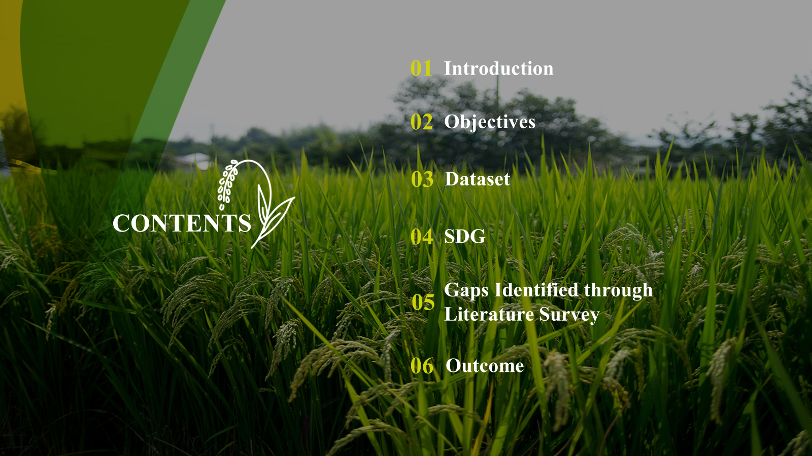

Slide 3


Slide 4
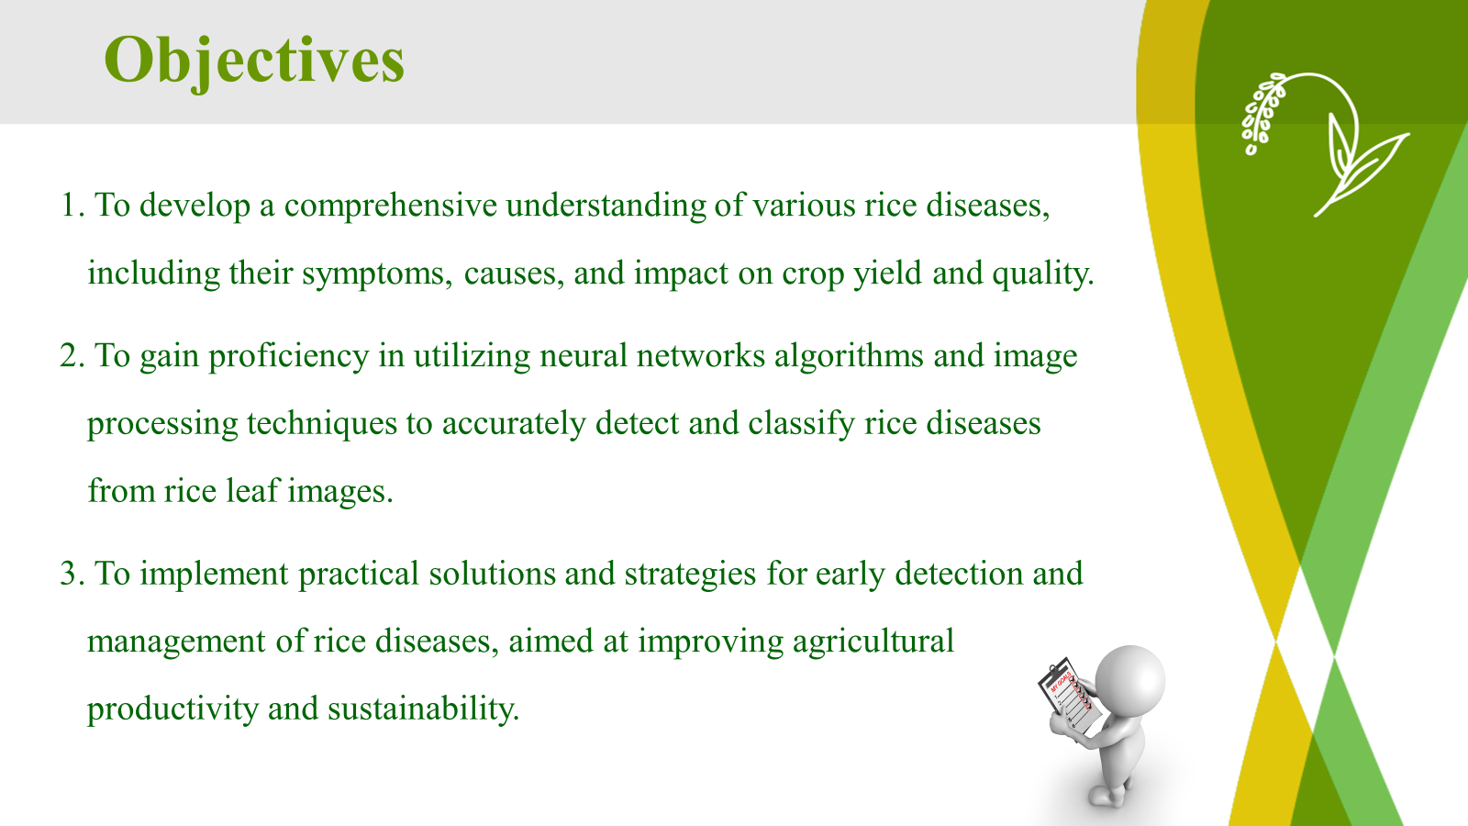

Slide 5
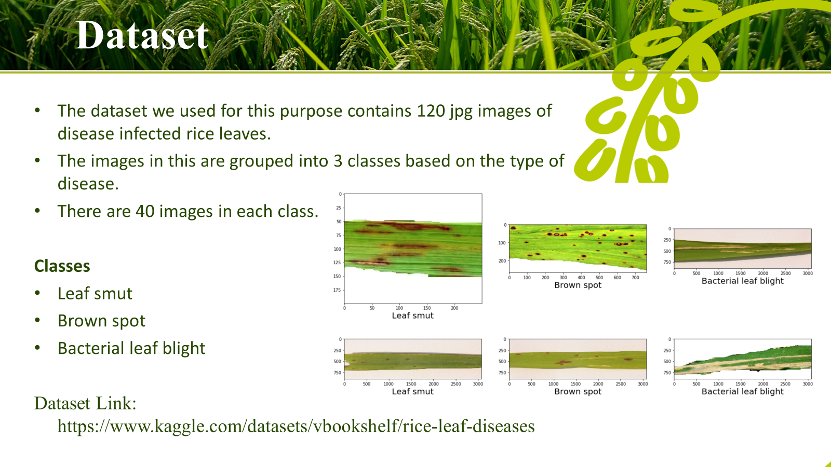

Slide 6

Dataset structure
Attribute | Description
Images Type | JPEG
Resolution | 300 dpi
No. of Images | 120
Link of Kaggle Dataset | Rice Leaf Diseases Dataset (kaggle.com)
No. of Classes | 3 with 120 images each

Slide 7


Slide 8
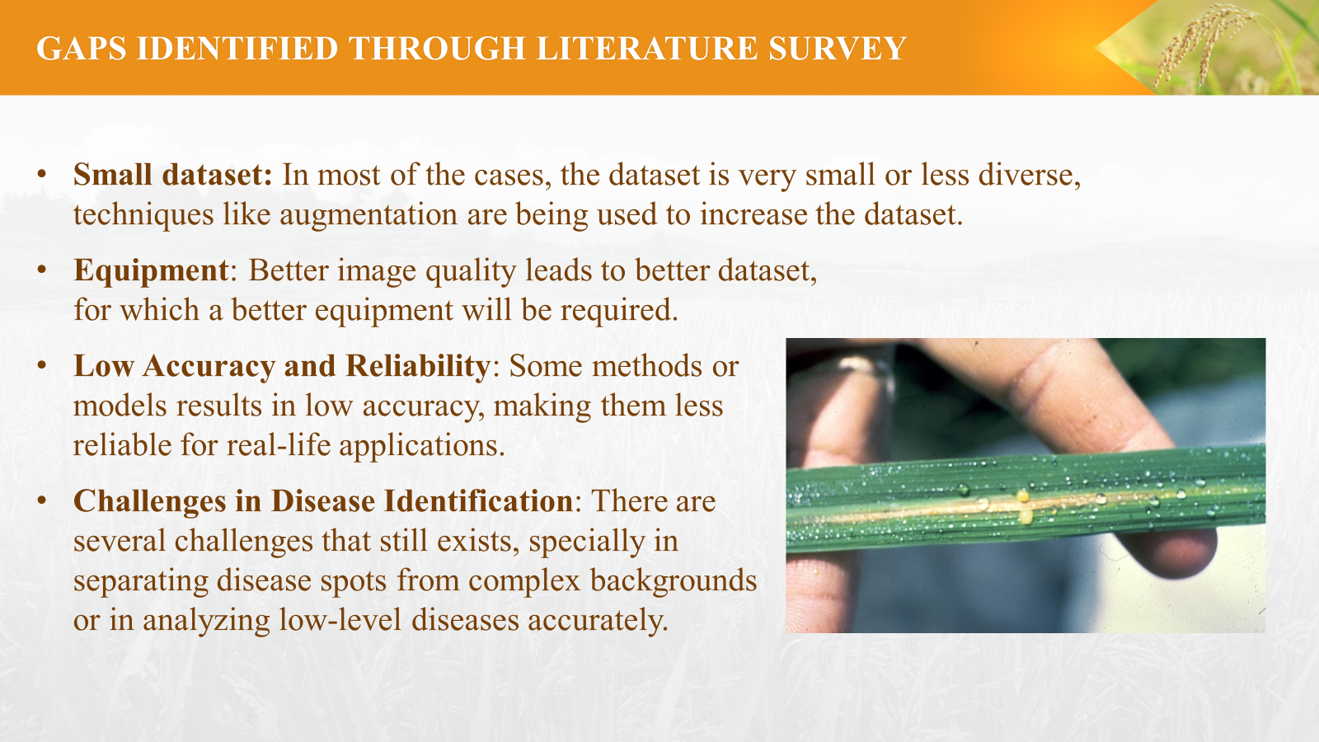

Slide 9
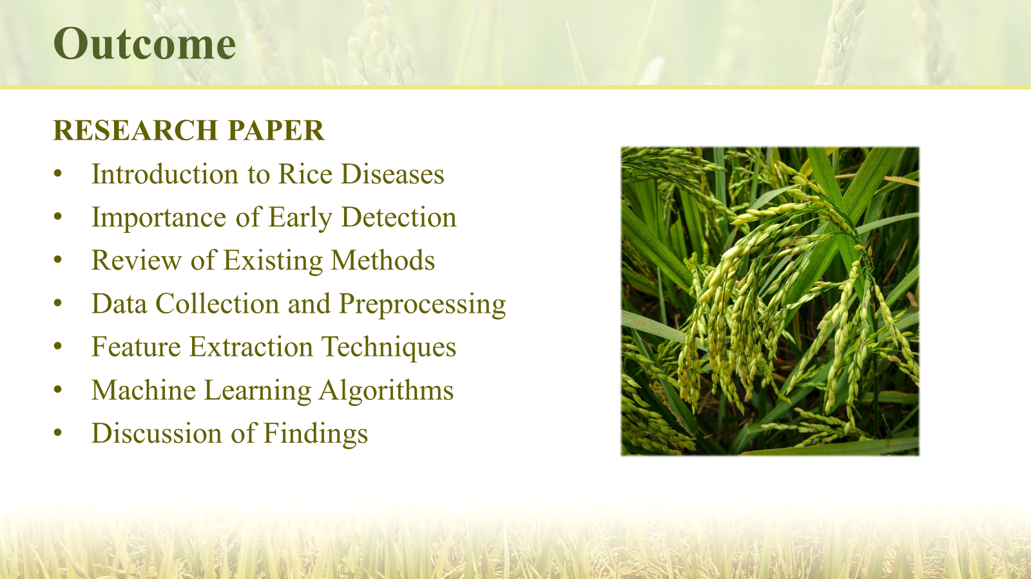

Slide 10

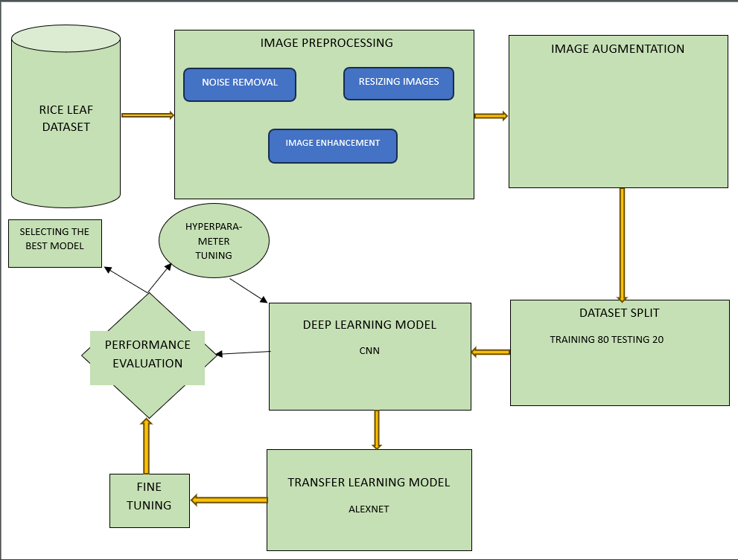
Methodology

Slide 11

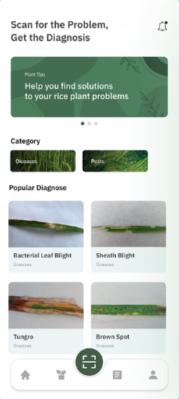
Novelty
Our project introduces a user-friendly interface for rice disease classification, enabling users to upload rice images effortlessly and obtain disease predictions swiftly, thereby streamlining crop monitoring and enhancing agricultural productivity.

Slide 12


